Slide 1
A2 – Galileo’s Inclined Plane

Slide 2
A1/A2 Lab Report
Common issues:
No titles on graphs
Correct font and format (see sample report)
Important values in Summary
Page numbers
References must fit in 7 page limit
Too much white space
Fonts on figures too small
Schematics are all blue
Proofread the printed version
START EARLY!

Slide 3
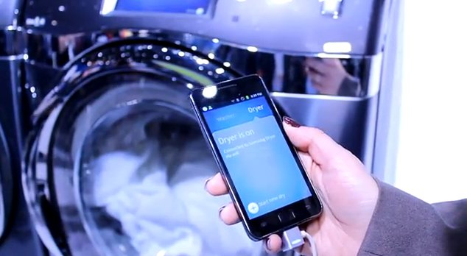
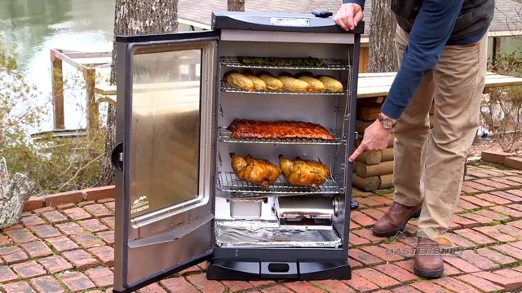
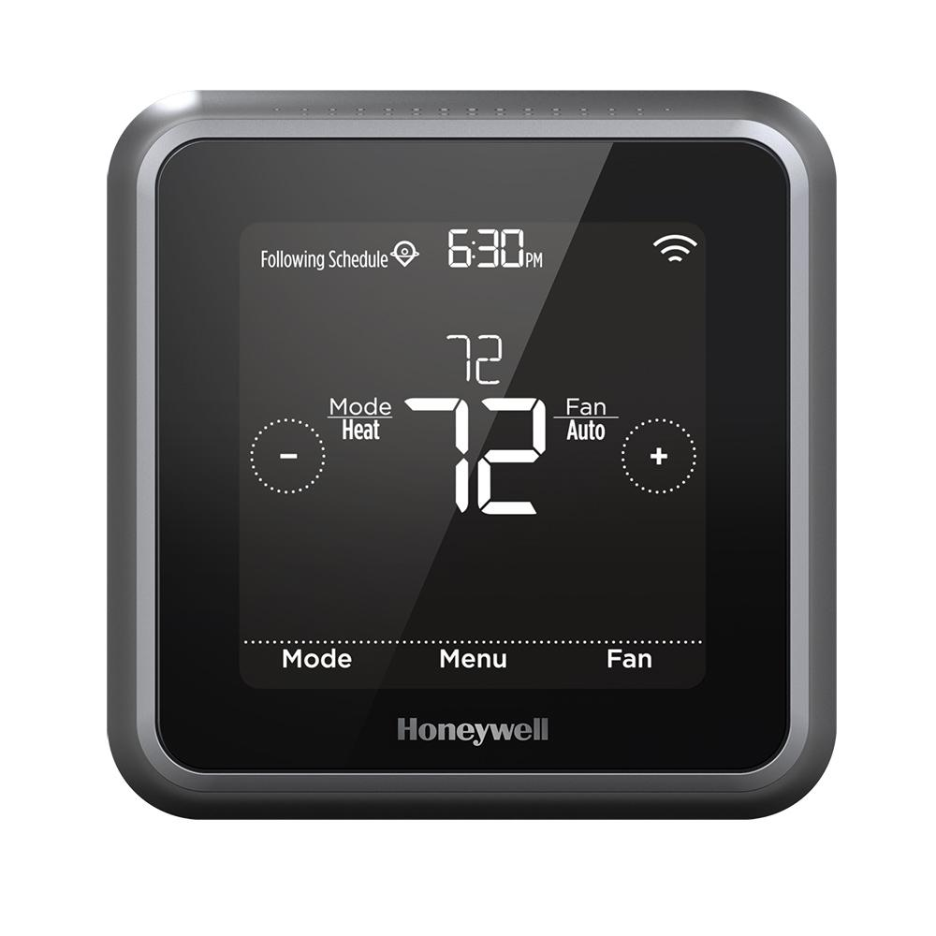
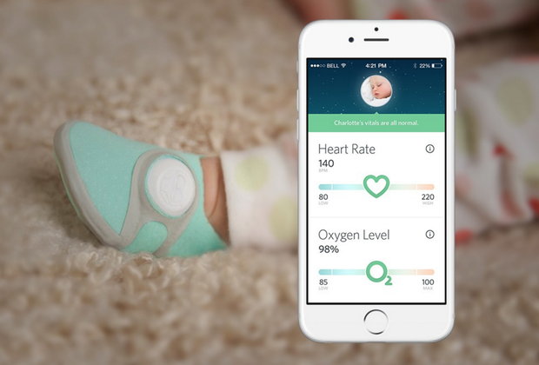
Internet of Things (IoT) – Sensors galore!

Slide 4
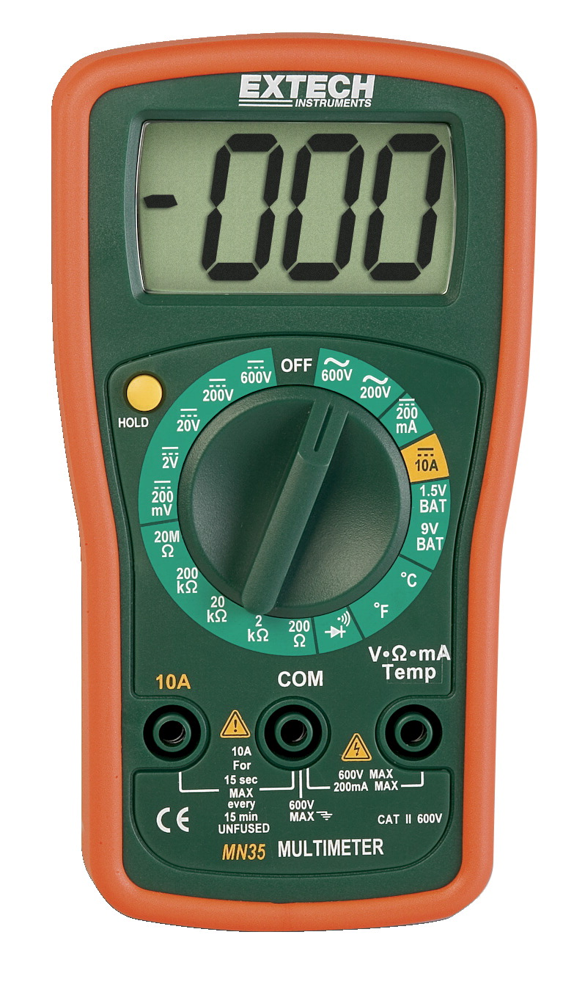
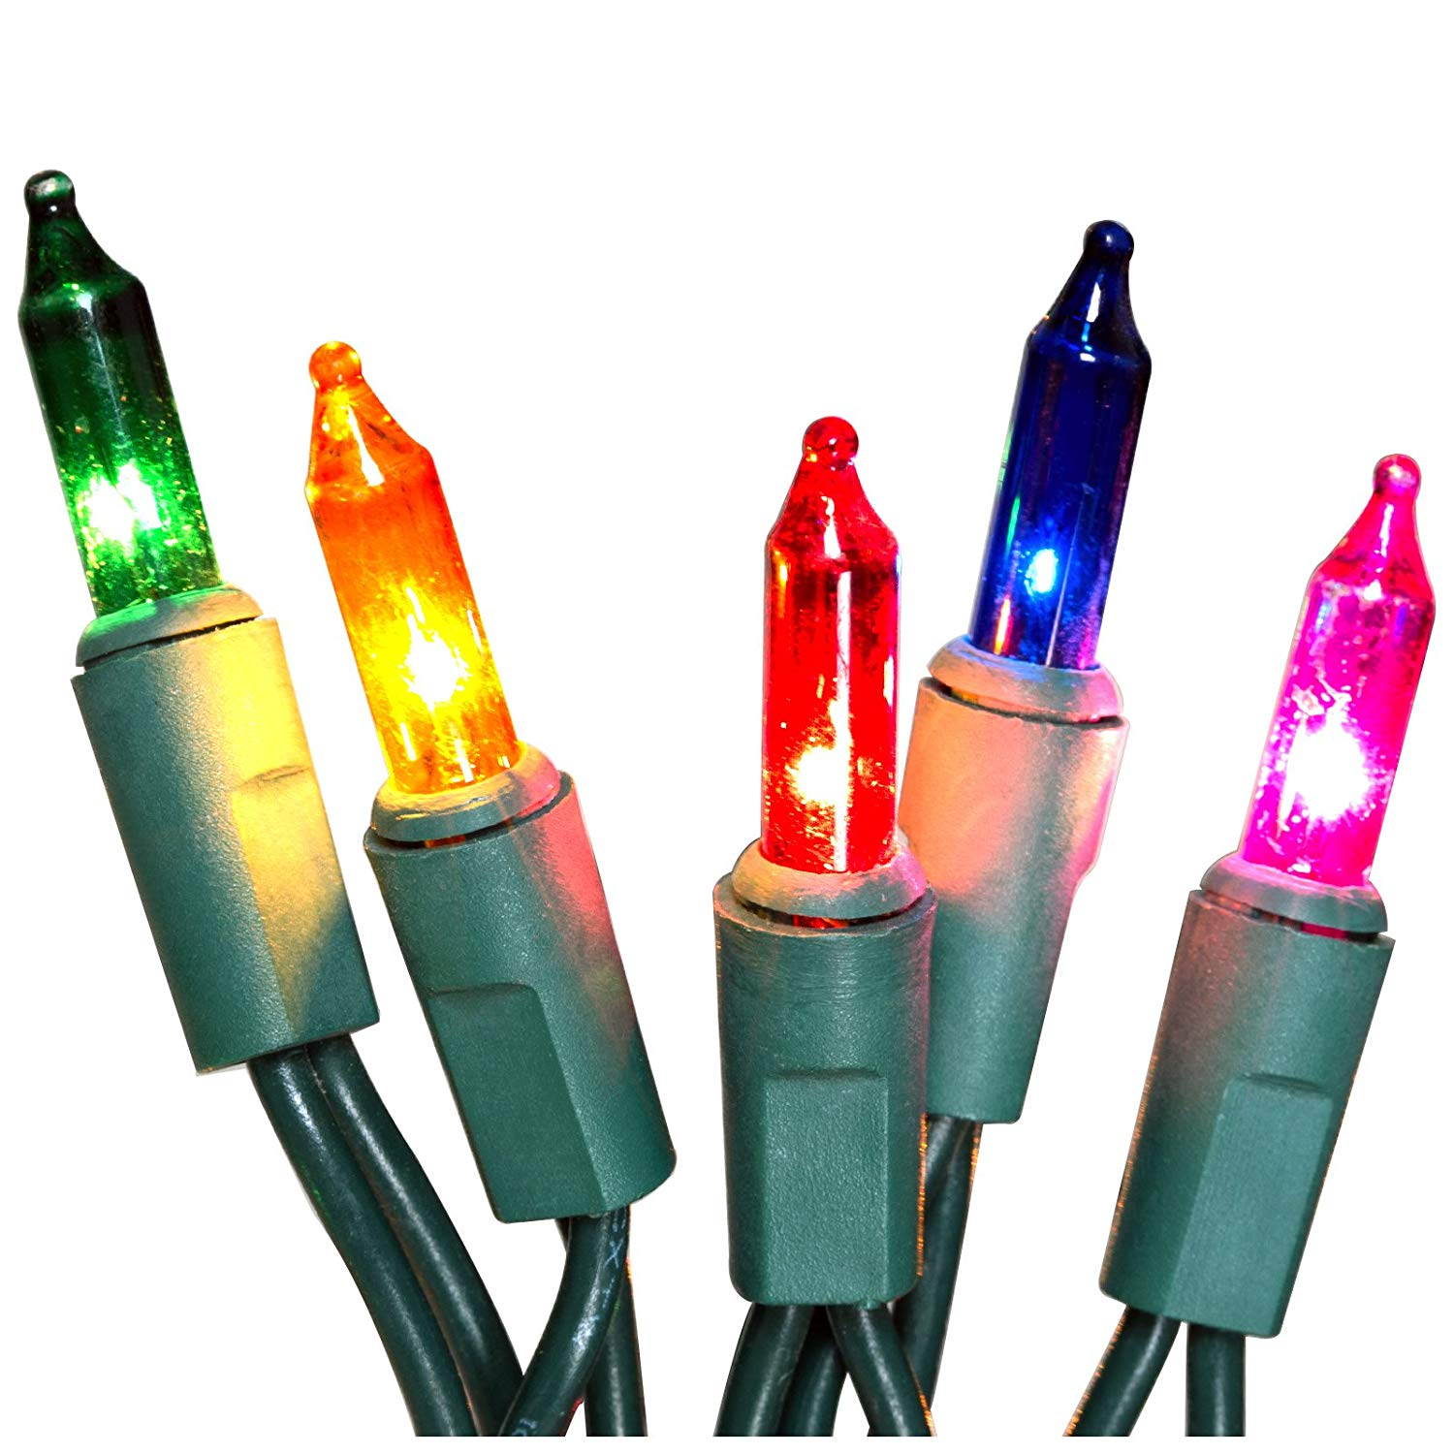
A3 – Electronics I
Extech Handheld DMM
Christmas Lights

Slide 5
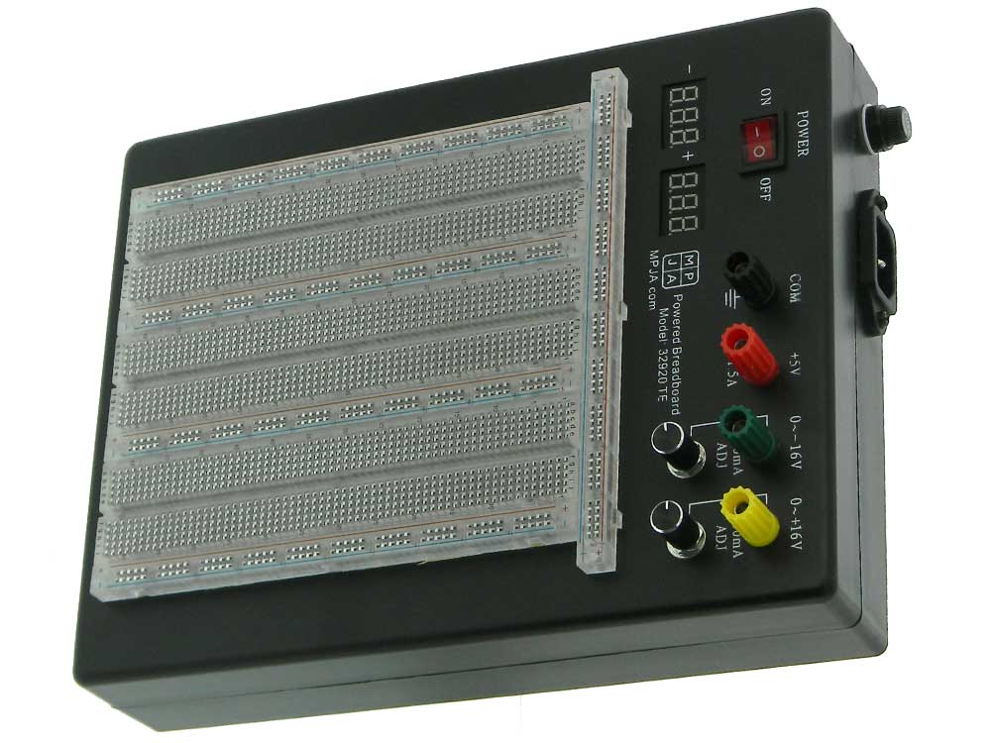
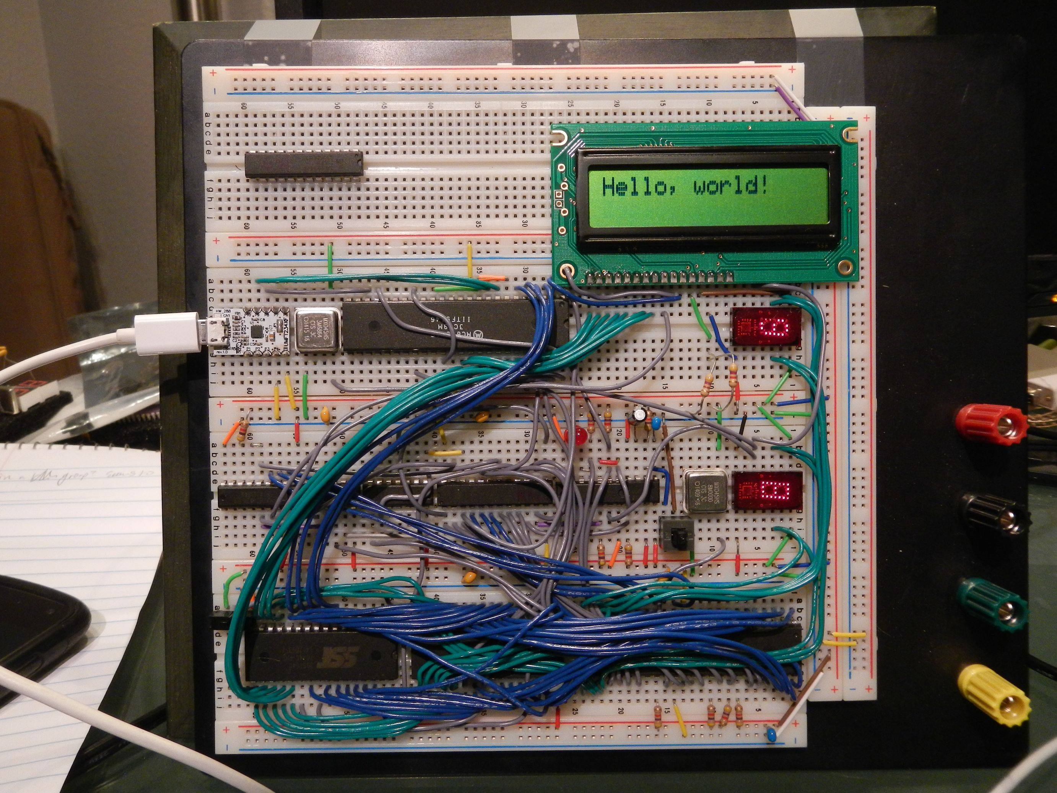
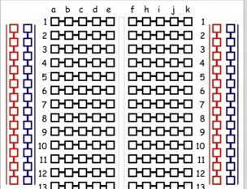
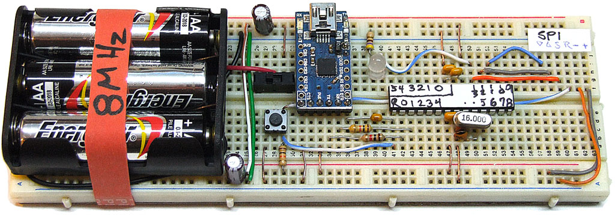
A3 – Electronics I
Solderless breadboard

Slide 6
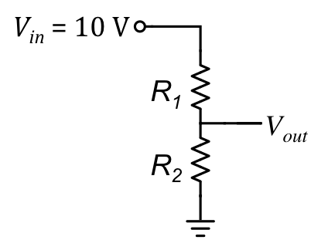
A3 – Electronics I
Voltage divider circuit
3-Way Switch

Slide 7
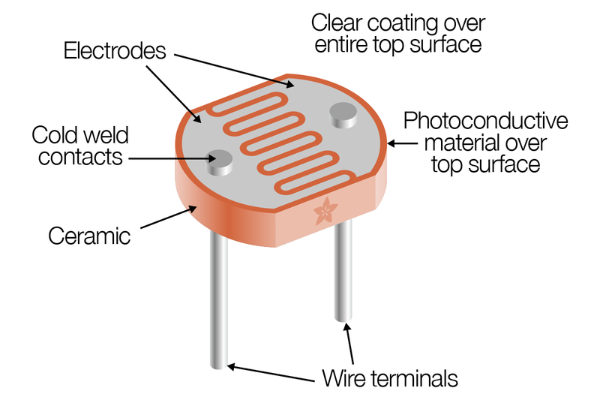
Cadmium Sulfide (CdS) Photocell
Resistance of Photocell changes when illuminated.

